Slide 1
Making Today’s Internet Faster
(Automatic Transition To Peer-to-Peer Download)
Roger Pack
MS Thesis
Notes:
Formal
use “automatic swarming” or I
25 minutes or so
Nothing in hands

Slide 2

Fast download

Slide 3

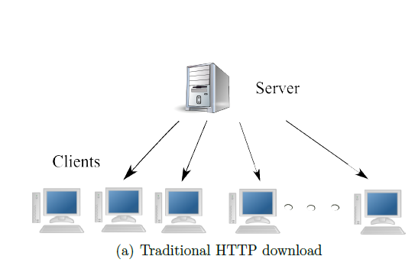
Slow downloads
Relative frustration
Wasted bandwidth
Server under-provisioned
Internet congestion
Flash crowd

Slide 4
Your options
Wait
Parallel download manager
Add a local caching proxy

Slide 5

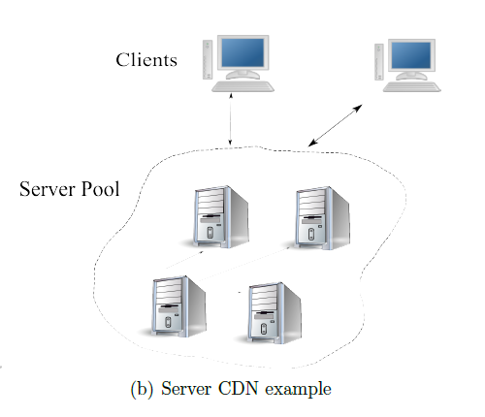
Server options
Buy more bandwidth
Rent a CDN
Turn to P2P

Slide 6

CDN can fail
Overloaded
Expensive

Slide 7

Turn to P2P
BitTorrent
Create + host BitTorrent File
Run a tracker
Peers download and share blocks (efficiently)
Works well for large popular files
“When I created BitTorrent in 2001, my mission was to solve the problem every website has when distributing large, popular files” – Bram Cohen

Slide 8
BitTorrent downsides
Server side
Per File
Have to provide traditional anyway
Lack of clients
Stigma
Extra maintenance
Large Files
Unknown demand

Slide 9
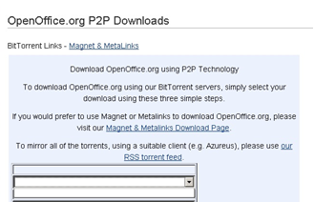
BitTorrent downsides
Clients
Extra setup/time per file
Small files
Technical expertise
Not integrated
Manual
Not HTTP optimized
Often slower than client-server
Costs time
Warmup phase
Not enough seeds
Not available
Notes:
Viz: The more general problem is that when downloading typical files from the Internet, BitTorrent cannot come to your aid

Slide 10
Related Work
Client-side protocols
Squirrel
No transition
Extra hop
No swarming
Server-side protocols
Backslash
Limited by servers’ bandwidth
Cooperative protocols
BitTorrent

Slide 11
Automatic Swarming
Automatic Transition to Peer-to-peer download
Monitor download
Automatically switch if it becomes slow

Slide 12
Automatic Swarming -- Goals
Overcome deficiencies of BitTorrent
Work for any file on any server without configuration
Easy for client use
No extra hardware
Work for small files
Non intrusive
Don’t cache other people’s files
Legal
Wouldn’t it be great if this was built into Internet Explorer and Firefox?
Make swarming more adoptable
All downloads
Notes:
Something like this, should it exist, would be quite useful if it were built into IE

Slide 13
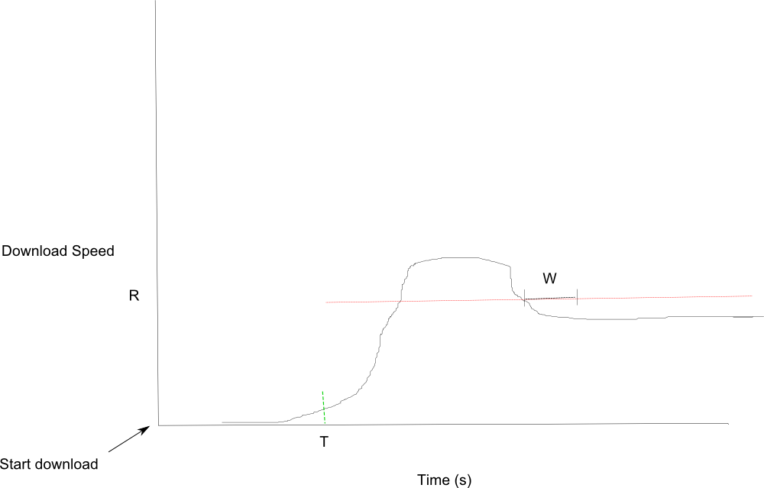
Monitoring Downloads

Slide 14
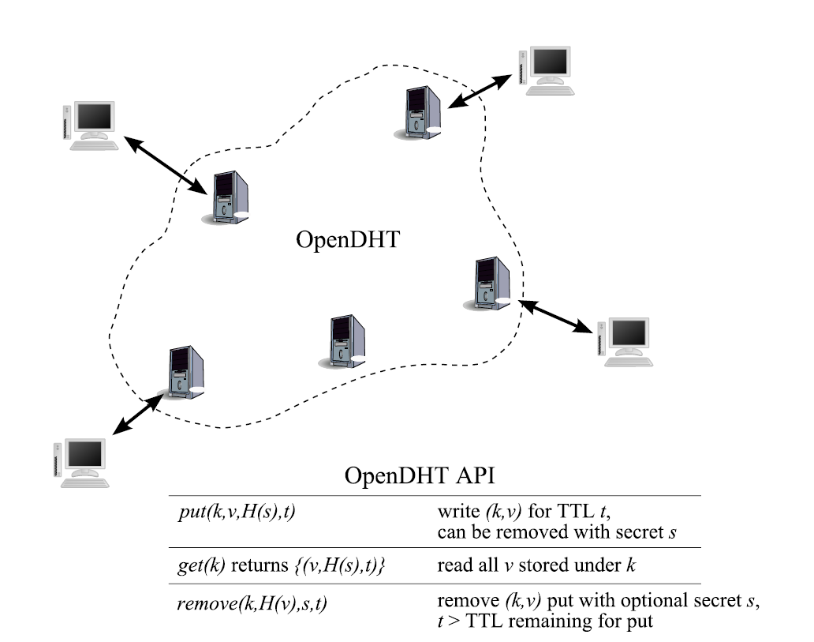
Finding Peers
OpenDHT
Scalable, distributed lookup
Runs as service

Slide 15
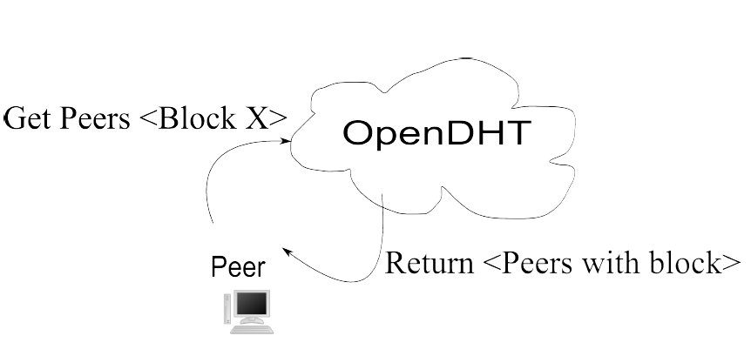
P2P Delivery
Query for peers
Per block
Redundant queries
Poll on none found
Download from the origin while polling
When find live peer, download
Last block

Slide 16
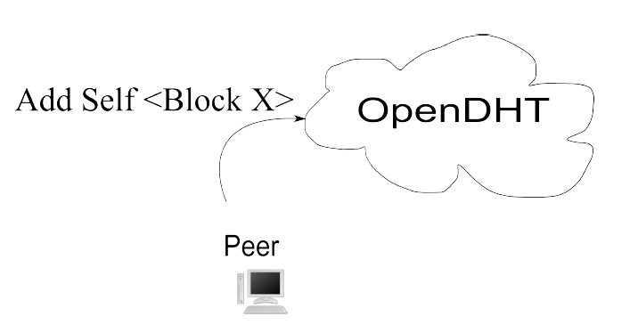
P2P Sharing
Linger

Slide 17
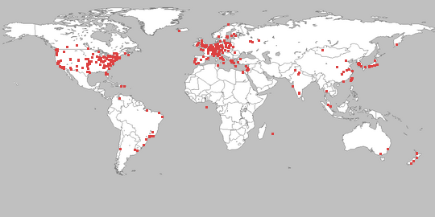
Methodology
PlanetLab
Private OpenDHT

Slide 18

Methodology
BYU server
256 KB/s
Start multiple clients over some time
Run until finish
Repeat 3x
Graph percentiles
download times
DHT response times
causes for transitioning to P2P

Slide 19
Scalability Test
Load
File size: 100 KB
R 128 KB/s
W 2s
T 1s
Linger 60s
100 s
Client count increases from 1 to 20 peers/second
Both Client-Server and Automatic Swarming
Notes:
Note that a semi-popular website might serve half a
million hits a day, which averages to 6 per second, so our limit of 20 per second is similar, if
you take into consideration spikes in load

Slide 20
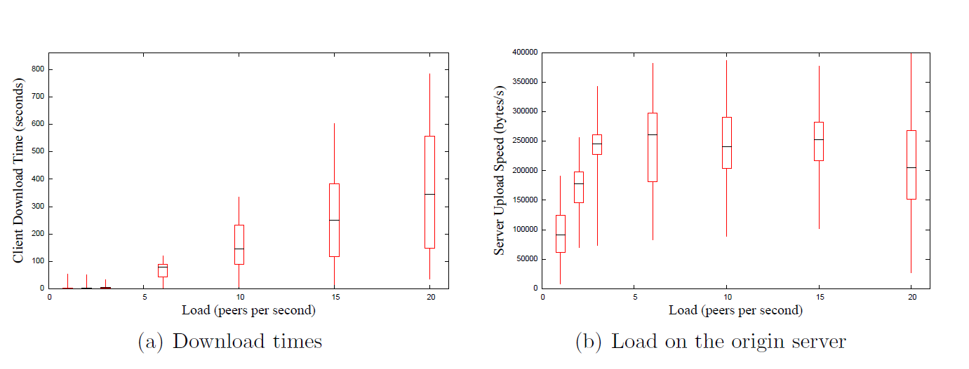
Performance – Client-Server

Slide 21
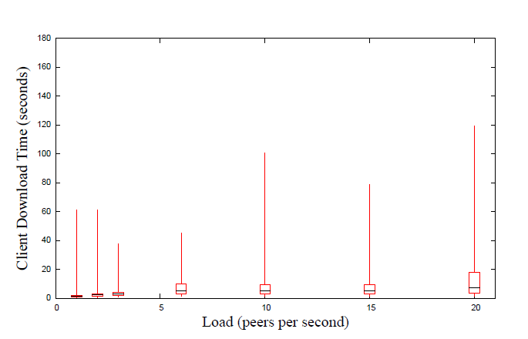
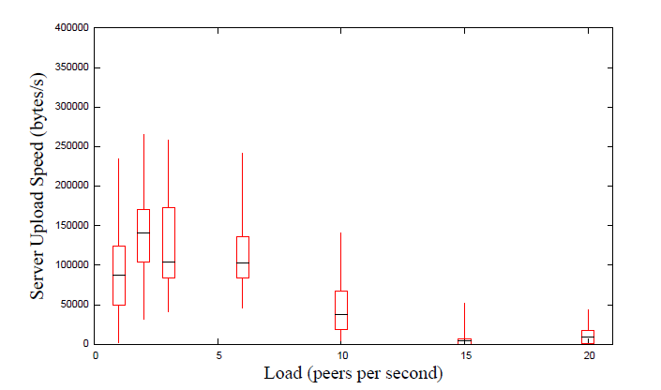
Performance – Automatic Swarming
99.5% transition because of T
DHT median latency of 5.2 seconds

Slide 22
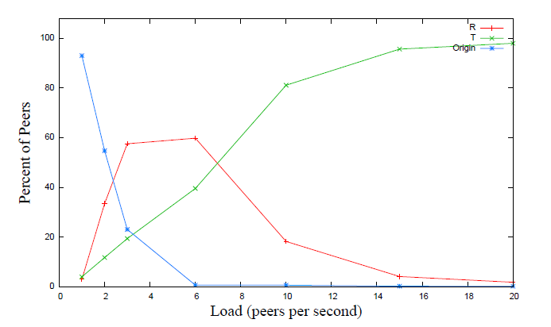
Automatic Swarming – Transition Causes
T – first byte timeout
R – server speed too low
Origin – did not transition to P2P

Slide 23
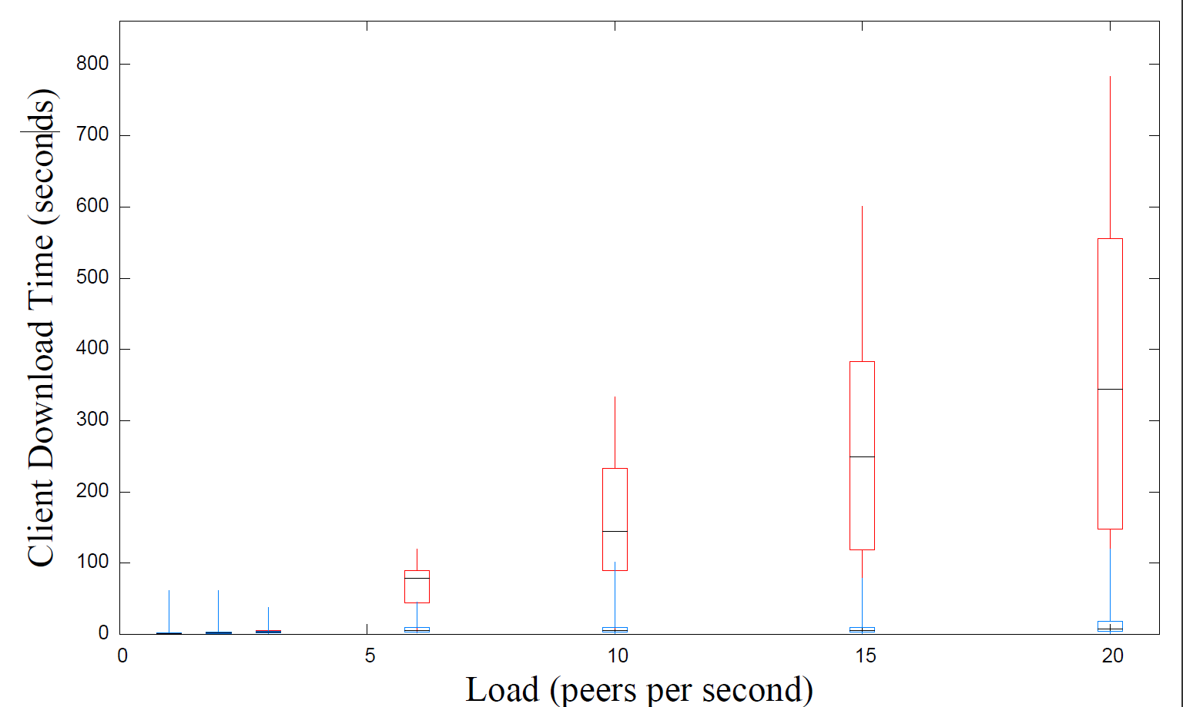
Comparison
30x faster

Slide 24
Individual Parameter Tests
Load
1000 peers
15 peers/s
File size: 100 KB
R 128 KB/s
W 2s
T 1s
Linger 20s
Vary one parameter, hold rest constant
Notes:
Could avoid this slide altogether, I suppose.

Slide 25
Optimal Values
T: 0.75 s
Prefer low
R: 160 KB/s
W: 0.25 s
Prefer low
Block size: 32 KB
Parallelize
Peer concurrency count: 16 +

Slide 26
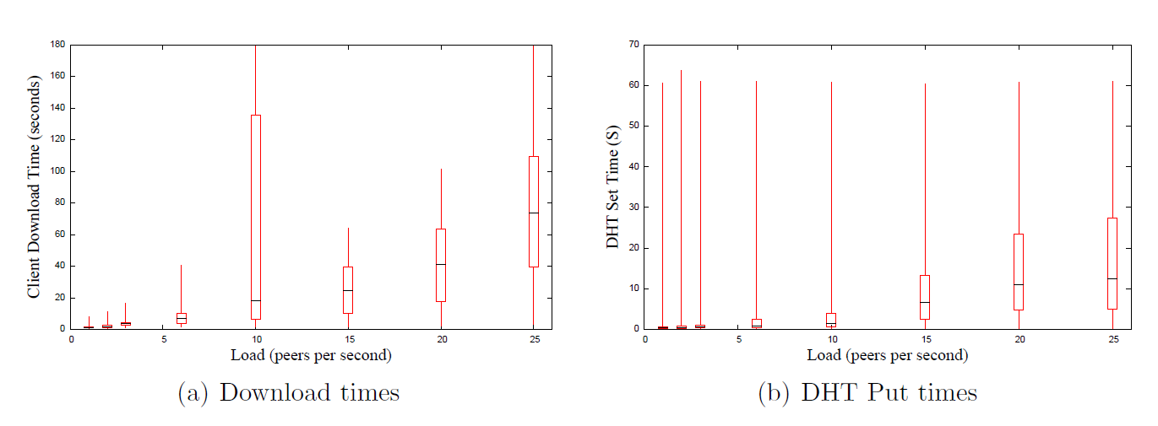
Full Web Page
100 KB file, 10 10K files
10 x as much load on the DHT
Linger time 20 seconds

Slide 27
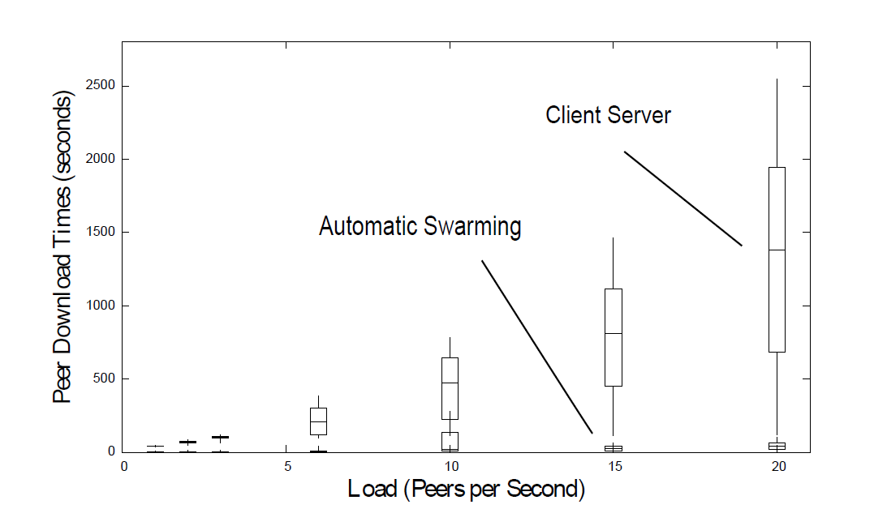
Multiple Files Versus Client-Server
20x faster

Slide 28
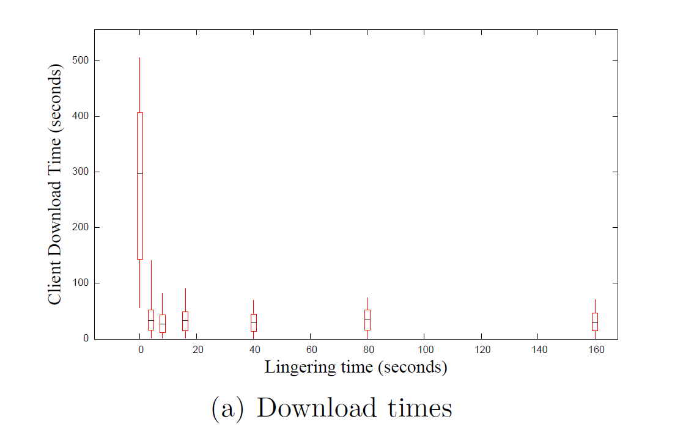
Linger Time

Slide 29
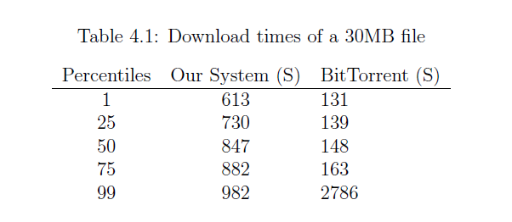
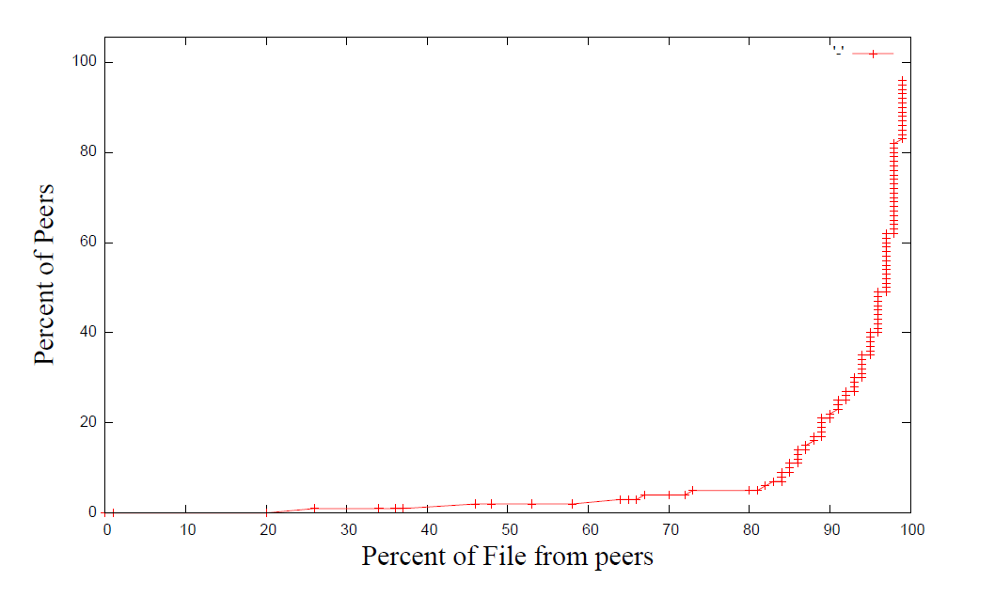
With Large Files
Fast once it gets started for both
Notes:
“Ours doesn’t perform as well as BT for large files”
You can see that at about 730 to 882 seconds most of our peers finish the file, and most of the peers download it from peers, so once we get the file out there we work all right, but we could do some work still to increase our speed of propagating the blocks”

Slide 30
BitTorrent’s Large File Optimizations
Seeds limit outgoing connections
Favors stronger connections
Dedicated tracker
Rarest Block First

Slide 31
Conclusion
Feasible transition to Peer-to-Peer download
30x as fast for small files (flash crowd)
20x as fast for web pages
Reduces load on the server
Make swarming more usable/adoptable

Slide 32
Automatic Swarming -- Goals
Work for any file on any server without configuration
Easy for client use
No extra dedicated hardware
Work for small files
Non intrusive

Slide 33
Future Work
Improve DHT performance
Improve automatic swarming for large files
General performance tuning and dynamic selection of parameters
Better use of the DHT
Staleness
BitTorrent features
Validate Integrity
Incentives

Slide 34
Questions?

